Slide 1
www.MINEPORTAL.in
ONLINE TEST SERIES FOR
DGMS COAL/METAL FIRST/SECOND CLASS EXAM
GATE MINING EXAM
OVERMAN EXAM TEST
MINING INSPECTOR EXAMS
COAL INDIA MTs & OTHER PSUs EXAMS
FREE STUDY MATERIAL & VIDEO LECTURES
MINING JOBS NOTIFICATIONS
www.mineportal.in Call/Whatsapp-8804777500 www.fb.com/mineportal.in

Slide 2
Variety of Mine Plans and Sections
Surface Plan
Showing every feature such as telephone, telegraph, railway, road river, opencast workings, subsidence, shaft and incline opening, benchmark with its R.L., contours interval not exceeding 5m.
On the plane the grid line should be worked in squares of 250m side.
Underground Plan
The position of workings belowground, every borehole and shaft with depth, drift, incline, pumping stations, etc..
Every important features with in the boundaries such as railway track, river, reservoir and building within 200m of any part of the strata.
Dip direction with the rate and strike direction.
Section of the seam.
Position of every dyke, fault with amount of throw and its direction.
Surface control not exceeding 5m.
Spot levels on the floor of working along all haulage roadway.
A permanent on the surface with its R.L..
The workings and other features, both above and below ground of all adjacent mines situated within 60m.

Slide 3
Working lines indicating the outlines of bodies of water.
An abstract of all statutory restrictions in respect of any specified workings.
Vertical Mine Sections
Showing a vertical projection of the mine workings, where a seam has an average dip of more than 30⁰ from the horizontal.
Ventilation Plan and Section
Showing the system of ventilation in mine and in particular the general direction of air, air crossings, ventilation door, stopping, the position of fire-fighting equipment and stone dust barrier (with type and date of construction), every water dam with dimension etc..
Combined Section/Sections
In case of contiguous seams, each other showing the workings of different seams in different colors.
Combine/Composite Plan
Showing the extent of workings of all the seams lying within, the boundary of the mine, in different colors.
Geological Plan
Showing area of the lease hole in 1:5000 R.F., showing outcrops, dip direction, dykes, faults, burnt coal or any other geological feature in the area.

Slide 4
Rescue Plan/Tracing
At least three in nos. showing all details required on ventilation plan and escape route.
Water danger Plan
Showing existing danger due to flooding, showing highest known flood level, low lying lands to be affected by the floods, water bearing strata, unconsolidated strata.
Abandoned Mine Plan
Showing all details of abandoned mine required for underground plan.
Stone dusting Plan
Showing underground workings, divided into zones for stone dusting purposes, plan on a R.F. of 1:2400.
Sampling (zoning) Plan
In underground workings clearly indicating zones for sampling purposes, each not longer than 150m, and sections in each zone not longer than 50m each.
Fire-fighting Plan
Showing the location of the fire-fighting stations in underground, layout of the fire-fighting pipeline and tapping points and these should be available in sufficient nos. both at the surface and underground.

Slide 5
Joint Survey Plan
Showing workings and features of any adjacent mines with in 60m measured on any plane of the boundary claimed by the owners of the mine.
Electrical Plan
Showing position of electrical equipments together with their specifications, the position of cables, gate end box (GEB) together with their construction and capacities.
Subsidence Plan and sections
Showing observation points on the test line, depillared area, geological discontinuities and
The thickness and nature of overlying strata,
The conditions of overlying strata.
Angle of draw.
Amount of subsidence from time to time.
17. Sketch Plan for Systematic Support Rules
In respect of areas, where systematic support rules are enforced, giving details of the support rules.

Slide 6
Manpower distribution Plan
The number of persons employed in every district and other places belowground on any one day of the month shown on the plan. It should also indicate:
The month of which the plan relates,
A single line sketch of the main roadways, in different color when more than one seam,
The name of districts, with letter reference,
The no. of persons employed in each district category wise, and
The summary of the total no. of persons employed underground.
Accident Plan
Accident site plan, any accident occurs in a mine resulting in loss of life or serious bodily injury to any person, cause of the accident, indicating the name of the district, place, date and time of accident in brief.
20. Any other plan or section as required by the Regional Inspector of Mines.

Slide 7
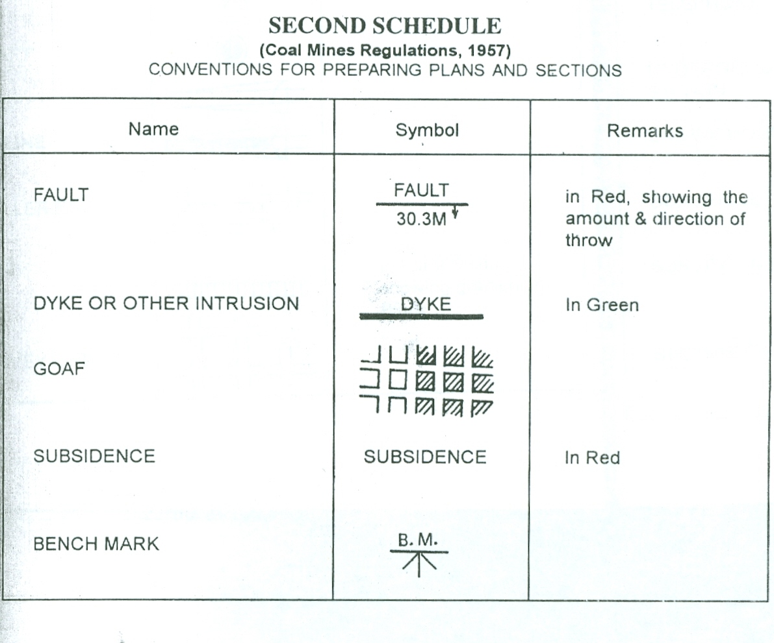

Slide 8
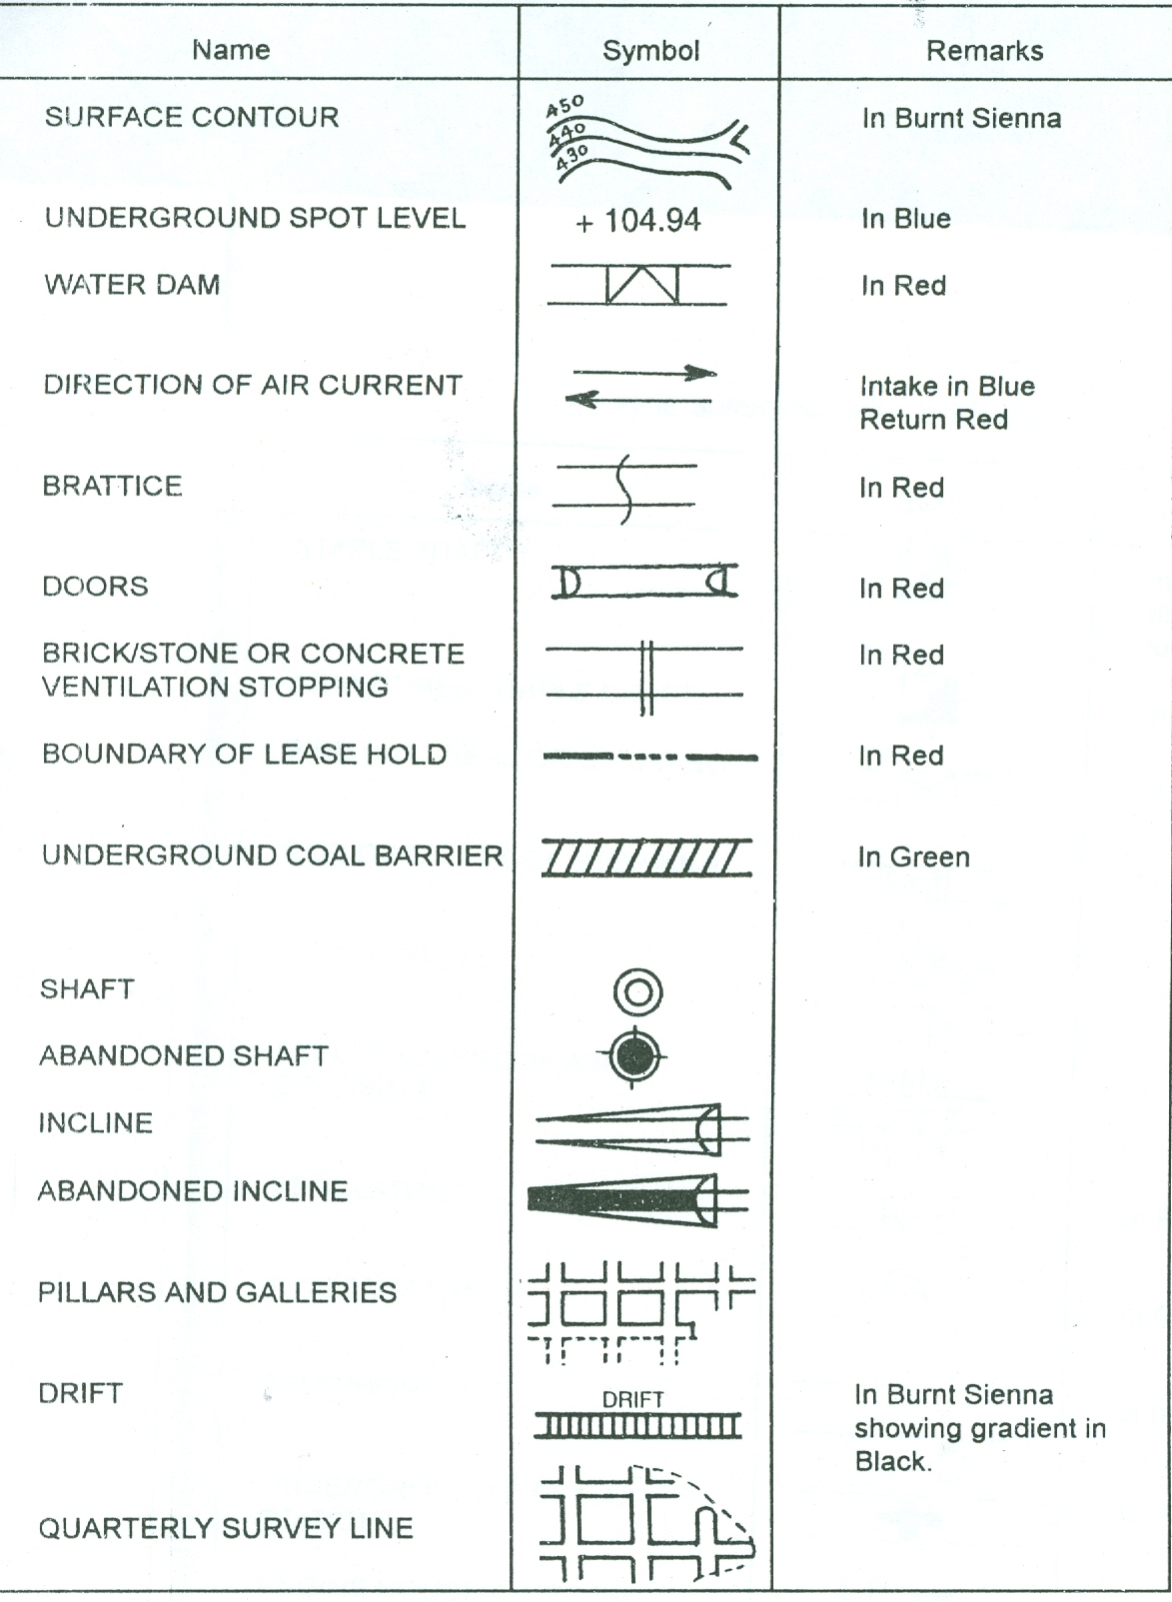

Slide 9
